Slide 1
Switching and Routing Essentials CT122-3-2 SRE
Wireless LAN Concepts and Configurations

Slide 2
Topic & Structure of The Lesson
Module Title: WLAN Concepts
Module Objective: Explain how WLANs enable network connectivity.
Topic Title | Topic Objective
Introduction to Wireless | Describe WLAN technology and standards.
Components of WLANs | Describe the components of a WLAN infrastructure.
WLAN Operation | Explain how wireless technology enables WLAN operation.
CAPWAP Operation | Explain how a WLC uses CAPWAP to manage multiple APs.
Channel Management | Describe channel management in a WLAN.
WLAN Threats | Describe threats to WLANs.
Secure WLANs | Describe WLAN security mechanisms.
Notes:
2
12- Introduction
12.0.2 – What will I learn in this module?

Slide 3
Learning Outcomes
At the end of this topic, You should be able to:
Describe WLAN technology and standards.
Describe the components of a WLAN infrastructure.
Explain how wireless technology enables WLAN operation.
Explain how a WLC uses CAPWAP to manage multiple APs.
Describe channel management in a WLAN.
Describe threats to WLANs.
Describe WLAN security mechanisms.
Notes:
The following guidelines and restrictions are useful for configuring EtherChannel:
All Ethernet interfaces on all modules must support EtherChannel with no requirement that interfaces be physically contiguous, or on the same module.
Configure all interfaces in an EtherChannel to operate at the same speed and in the same duplex mode.
All interfaces in the EtherChannel bundle must be assigned to the same VLAN or be configured as a trunk.
An EtherChannel supports the same allowed range of VLANs on all the interfaces in a trunking EtherChannel.
Configuring EtherChannel with LACP requires three steps:
Step 1. Specify the interfaces that compose the EtherChannel group using the interface range interface global configuration mode command.
Step 2. Create the port channel interface with the channel-group identifier mode active command in interface range configuration mode.
Step 3. To change Layer 2 settings on the port channel interface, enter port channel interface configuration mode using the interface port-channel command, followed by the interface identifier.
==================
To increase bandwidth or redundancy, multiple links could be connected between devices. However, STP will block redundant links to prevent switching loops. EtherChannel is a link aggregation technology that allows redundant links between devices that will not be blocked by STP.
EtherChannel groups multiple physical Ethernet links together into one single logical link. It provides fault-tolerance, load sharing, increased bandwidth, and redundancy between switches, routers, and servers.
When an EtherChannel is configured, the resulting virtual interface is called a port channel.
EtherChannels can be formed through negotiation using one of two protocols, PAgP or LACP. These protocols allow ports with similar characteristics to form a channel through dynamic negotiation with adjoining switches.
When an EtherChannel link is configured using Cisco-proprietary PAgP, PAgP packets are sent between EtherChannel-capable ports to negotiate the forming of a channel. Modes for PAgP are On, PAgP desirable, and PAgP auto.
LACP performs a function similar to PAgP with Cisco EtherChannel. Because LACP is an IEEE standard, it can be used to facilitate EtherChannels in multivendor environments. Modes for LACP are On, LACP active, and LACP passive.
==============
There are a number of commands to verify an EtherChannel configuration including show interfaces port-channel, show etherchannel summary, show etherchannel port-channel, and show interfaces etherchannel.
Common EtherChannel issues include the following:
Assigned ports in the EtherChannel are not part of the same VLAN, or not configured as trunks.
Ports with different native VLANs cannot form an EtherChannel.
Trunking was configured on some of the ports that make up the EtherChannel, but not all of them.
If the allowed range of VLANs is not the same, the ports do not form an EtherChannel even when PAgP is set to the auto or desirable mode.
The dynamic negotiation options for PAgP and LACP are not compatibly configured on both ends of the EtherChannel.

Slide 4
Key Terms You Must Be Able To Use
If you have mastered this topic, you should be able to use the following terms correctly in your assignments and exams:
WPAN
WLAN
WMAN
WWAN
Bluetooth
802.11
Electromagnetic spectrum
ITU, IEEE
Lightweight AP (LAP)
Lightweight Access Point Protocol (LWAPP)
Wireless LAN Controller (WLAC)
SSID
Autonomous AP
Controller-based AP
Omni directional antenna
Directional antenna
MIMO antenna
Ad hoc mode
Infrastructure mode
Notes:
channel-group X mode [ desirable | auto | active | passive ]
interface port-channel X
show interfaces port-channel
show etherchannel summary
show etherchannel port-channel
show interfaces etherchannel

Slide 5
Introduction to Wireless
Notes:
12 - WLAN Concepts
12.1 – Introduction to Wireless

Slide 6

Introduction to Wireless Benefits of Wireless
A Wireless LAN (WLAN) is a type of wireless network that is commonly used in homes, offices, and campus environments.
WLANs make mobility possible within the home and business environments.
Wireless infrastructures adapt to rapidly changing needs and technologies.
Notes:
12 – WLAN Concepts
12.1 – Introduction to Wireless
12.1.1 – Benefits of Wireless

Slide 7
Introduction to Wireless Types of Wireless Networks
Wireless Personal-Area Network (WPAN) – Low power and short-range (20-30ft or 6-9 meters). Based on IEEE 802.15 standard and 2.4 GHz frequency. Bluetooth and Zigbee are WPAN examples.
Wireless LAN (WLAN) – Medium sized networks up to about 300 feet. Based on IEEE 802.11 standard and 2.4 or 5.0 GHz frequency.
Wireless MAN (WMAN) – Large geographic area such as city or district. Uses specific licensed frequencies.
Wireless WAN (WWAN) – Extensive geographic area for national or global communication. Uses specific licensed frequencies.
Notes:
12 – WLAN Concepts
12.1 – Introduction to Wireless
12.1.2 – Types of Wireless Networks

Slide 8

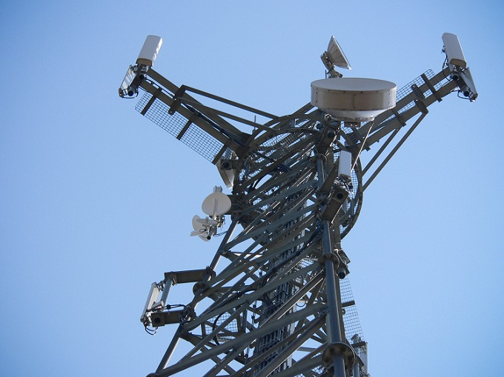
Introduction to Wireless Wireless Technologies
Bluetooth – IEEE WPAN standard used for device pairing at up to 300ft (100m) distance.
Bluetooth Low Energy (BLE) – Supports mesh topology to large scale network devices.
Bluetooth Basic Rate/Enhanced Rate (BR/EDR) – Supports point-to-point topologies and is optimized for audio streaming.
WiMAX (Worldwide Interoperability for Microwave Access) – Alternative broadband wired internet connections. IEEE 802.16 WLAN standard for up 30 miles (50 km).
Notes:
12 – WLAN Concepts
12.1 – Introduction to Wireless
12.1.3 – Wireless Technologies

Slide 9
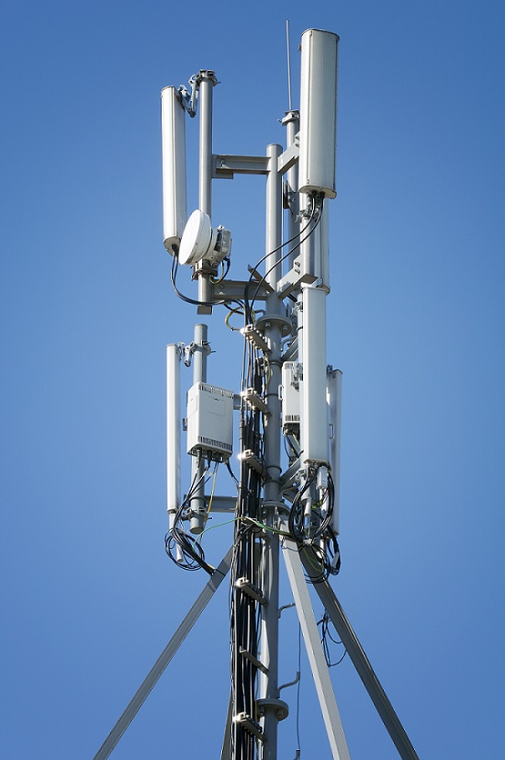

Introduction to Wireless Wireless Technologies (Cont.)
Cellular Broadband – Carry both voice and data. Used by phones, automobiles, tablets, and laptops.
Global System of Mobile (GSM) – Internationally recognized
Code Division Multiple Access (CDMA) – Primarily used on the US.
Satellite Broadband – Uses directional satellite dish aligned with satellite in geostationary orbit. Needs clear line of site. Typically used in rural locations where cable and DSL are unavailable.
Notes:
12 – WLAN Concepts
12.1 – Introduction to Wireless
12.1.3 – Wireless Technologies (Cont.)

Slide 10
Introduction to Wireless 802.11 Standards
802.11 WLAN standards define how radio frequencies are used for wireless links.
IEEE Standard | Radio Frequency | Description
802.11 | 2.4 GHz | Data rates up to 2 Mb/s
802.11a | 5 GHz | Data rates up to 54 Mb/s Not interoperable with 802.11b or 802.11g
802.11b | 2.4 GHz | Data rates up to 11 Mb/s Longer range than 802.11a and better able to penetrate building structures
802.11g | 2.4 GHz | Data rates up to 54 Mb/s Backward compatible with 802.11b
802.11n | 2.4 and 5 GHz | Data rates 150 – 600 Mb/s Require multiple antennas with MIMO technology
802.11ac | 5 GHz | Data rates 450 Mb/s – 1.3 Gb/s Supports up to eight antennas
802.11ax | 2.4 and 5 GHz | High-Efficiency Wireless (HEW) Capable of using 1 GHz and 7 GHz frequencies
Notes:
12 – WLAN Concepts
12.1 – Introduction to Wireless
12.1.4 – 802.11 Standard

Slide 11
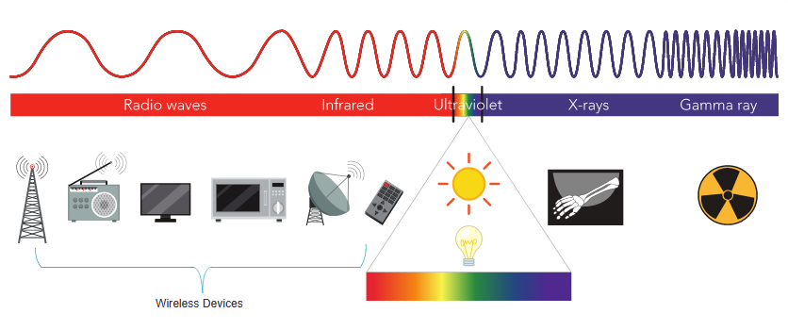
Introduction to Wireless Radio Frequencies
All wireless devices operate in the range of the electromagnetic spectrum. WLAN networks operate in the 2.4 and 5 GHz frequency bands.
2.4 GHz (UHF) – 802.11b/g/n/ax
5 GHz (SHF) – 802.11a/n/ac/ax
Notes:
12 – WLAN Concepts
12.1 – Introduction to Wireless
12.1.5 – Radio Frequencies

Slide 12
Introduction to Wireless Wireless Standards Organizations
Standards ensure interoperability between devices that are made by different manufacturers. Internationally, the three organizations influencing WLAN standards:
International Telecommunication Union (ITU) – Regulates the allocation of radio spectrum and satellite orbits.
Institute of Electrical and Electronics Engineers (IEEE) – Specifies how a radio frequency is modulated to carry information. Maintains the standards for local and metropolitan area networks (MAN) with the IEEE 802 LAN/MAN family of standards.
Wi-Fi Alliance – Promotes the growth and acceptance of WLANs. It is an association of vendors whose objective is to improve the interoperability of products that are based on the 802.11 standard
Notes:
12 – WLAN Concepts
12.1 – Introduction to Wireless
12.1.6 – Wireless Standards Organizations
12.1.7 – Check Your Understanding – Introduction to Wireless

Slide 13
WLAN Threats
Notes:
12 - WLAN Concepts
12.6 – WLAN Threats

Slide 14
WLAN Threats Video – WLAN Threats
This video will cover the following:
Interception of Data
Wireless Intruders
Denial of Service (DoS) Attacks
Rogue APs
Notes:
12 – WLAN Concepts
12.6 – WLAN Threats
12.6.1 – Video – WLAN Threats

Slide 15
WLAN Threats Wireless Security Overview
A WLAN is open to anyone within range of an AP and the appropriate credentials to associate to it.
Attacks can be generated by outsiders, disgruntled employees, and even unintentionally by employees. Wireless networks are specifically susceptible to several threats, including the following:
Interception of data
Wireless intruders
Denial of Service (DoS) Attacks
Rogue APs
Notes:
12 – WLAN Concepts
12.6 – WLAN Threats
12.6.2 – Wireless Security Overview

Slide 16
WLAN Threats DoS Attacks
Wireless DoS attacks can be the result of the following:
Improperly configured devices
A malicious user intentionally interfering with the wireless communication
Accidental interference
To minimize the risk of a DoS attack due to improperly configured devices and malicious attacks, harden all devices, keep passwords secure, create backups, and ensure that all configuration changes are incorporated off-hours.
Notes:
12 – WLAN Concepts
12.6 – WLAN Threats
12.6.3 – DoS Attacks

Slide 17
WLAN Threats Rogue Access Points
A rogue AP is an AP or wireless router that has been connected to a corporate network without explicit authorization and against corporate policy.
Once connected, the rogue AP can be used by an attacker to capture MAC addresses, capture data packets, gain access to network resources, or launch a man-in-the-middle attack.
A personal network hotspot could also be used as a rogue AP. For example, a user with secure network access enables their authorized Windows host to become a Wi-Fi AP.
To prevent the installation of rogue APs, organizations must configure WLCs with rogue AP policies and use monitoring software to actively monitor the radio spectrum for unauthorized APs.
Notes:
12 – WLAN Concepts
12.6 – WLAN Threats
12.6.4 – Rogue Access Points

Slide 18
WLAN Threats Man-in-the-Middle Attack
In a man-in-the-middle (MITM) attack, the hacker is positioned in between two legitimate entities in order to read or modify the data that passes between the two parties.
A popular wireless MITM attack is called the “evil twin AP” attack, where an attacker introduces a rogue AP and configures it with the same SSID as a legitimate AP.
Defeating a MITM attack begins with identifying legitimate devices on the WLAN. To do this, users must be authenticated. After all of the legitimate devices are known, the network can be monitored for abnormal devices or traffic.
Notes:
12 – WLAN Concepts
12.6 – WLAN Threats
12.6.5 – Man-in-the-Middle Attack
12.6.6 – Check Your Understanding – WLAN Threats

Slide 19
Secure WLANs
Notes:
12 - WLAN Concepts
12.7 – Secure WLANs

Slide 20
Secure WLANs Video – Secure WLANs
This video will cover the following:
SSID Cloaking
MAC Address Filtering
Authentication and Encryption Systems (Open Authentication and Shared Key Authentication)
Notes:
12 – Secure WLANs
12.7 – Secure WLANs
12.7.1 – Video – Secure WLANs

Slide 21
Secure WLANs SSID Cloaking and MAC Address Filtering
To address the threats of keeping wireless intruders out and protecting data, two early security features were used and are still available on most routers and APs:
SSID Cloaking
APs and some wireless routers allow the SSID beacon frame to be disabled. Wireless clients must be manually configured with the SSID to connect to the network.
MAC Address Filtering
An administrator can manually permit or deny clients wireless access based on their physical MAC hardware address. In the figure, the router is configured to permit two MAC addresses. Devices with different MAC addresses will not be able to join the 2.4GHz WLAN.
Notes:
12 – WLAN Concepts
12.7 – Secure WLANs
12.7.2 – SSID Cloaking and MAC Address Filtering

Slide 22
Secure WLANs 802.11 Original Authentication Methods
The best way to secure a wireless network is to use authentication and encryption systems. Two types of authentication were introduced with the original 802.11 standard:
Open system authentication
No password required. Typically used to provide free internet access in public areas like cafes, airports, and hotels.
Client is responsible for providing security such as through a VPN.
Shared key authentication
Provides mechanisms, such as WEP, WPA, WPA2, and WPA3 to authenticate and encrypt data between a wireless client and AP. However, the password must be pre-shared between both parties to connect.
Notes:
12 – WLAN Concepts
12.7 – Secure WLANs
12.7.3 – 802.11 Original Authentication Methods

Slide 23
Secure WLANs Shared Key Authentication Methods
There are currently four shared key authentication techniques available, as shown in the table.
Authentication Method | Description
Wired Equivalent Privacy (WEP) | The original 802.11 specification designed to secure the data using the Rivest Cipher 4 (RC4) encryption method with a static key. WEP is no longer recommended and should never be used.
Wi-Fi Protected Access (WPA) | A Wi-Fi Alliance standard that uses WEP but secures the data with the much stronger Temporal Key Integrity Protocol (TKIP) encryption algorithm. TKIP changes the key for each packet, making it much more difficult to hack.
WPA2 | It uses the Advanced Encryption Standard (AES) for encryption. AES is currently considered the strongest encryption protocol.
WPA3 | This is the next generation of Wi-Fi security. All WPA3-enabled devices use the latest security methods, disallow outdated legacy protocols, and require the use of Protected Management Frames (PMF).
Notes:
12 – WLAN Concepts
12.7 – Secure WLANs
12.7.4 – Shared Key Authentication Methods

Slide 24
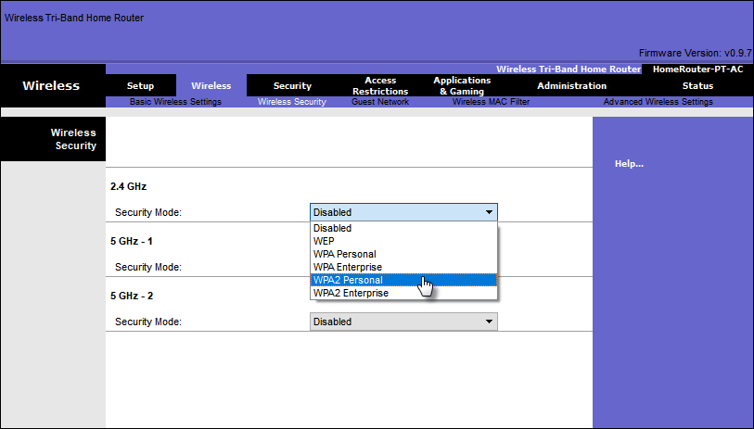
Secure WLANs Authenticating a Home User
Home routers typically have two choices for authentication: WPA and WPA2, with WPA 2 having two authentication methods.
Personal – Intended for home or small office networks, users authenticate using a pre-shared key (PSK). Wireless clients authenticate with the wireless router using a pre-shared password. No special authentication server is required.
Enterprise – Intended for enterprise networks. Requires a Remote Authentication Dial-In User Service (RADIUS) authentication server. The device must be authenticated by the RADIUS server and then users must authenticate using 802.1X standard, which uses the Extensible Authentication Protocol (EAP) for authentication.
Notes:
12 – WLAN Concepts
12.7 – Secure WLANs
12.7.5 – Authenticating a Home User

Slide 25
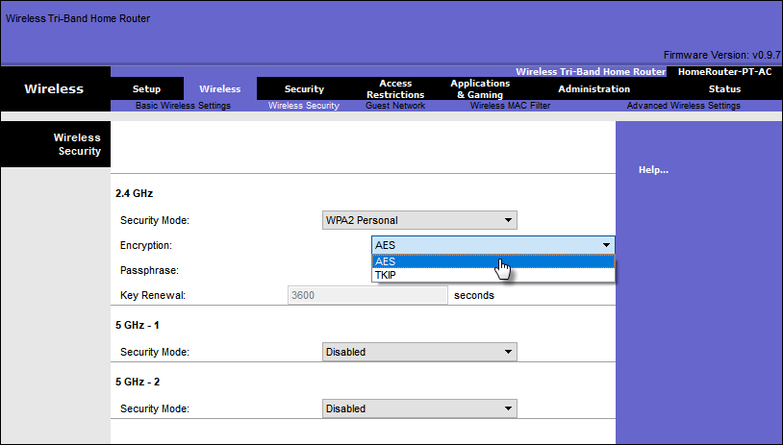
Secure WLANs Encryption Methods
WPA and WPA2 include two encryption protocols:
Temporal Key Integrity Protocol (TKIP) – Used by WPA and provides support for legacy WLAN equipment. Makes use of WEP but encrypts the Layer 2 payload using TKIP.
Advanced Encryption Standard (AES) – Used by WPA2 and uses the Counter Cipher Mode with Block Chaining Message Authentication Code Protocol (CCMP) that allows destination hosts to recognize if the encrypted and non-encrypted bits have been altered.
Notes:
12 – WLAN Concepts
12.7 – Secure WLANs
12.7.6 – Encryption Methods

Slide 26
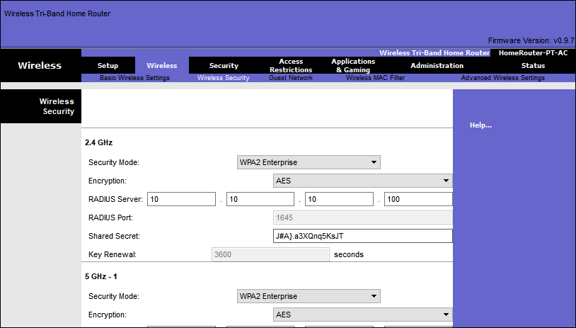
Secure WLANs Authentication in the Enterprise
Enterprise security mode choice requires an Authentication, Authorization, and Accounting (AAA) RADIUS server.
There pieces of information are required:
RADIUS server IP address – IP address of the server.
UDP port numbers –UDP ports 1812 for RADIUS Authentication, and 1813 for RADIUS Accounting, but can also operate using UDP ports 1645 and 1646.
Shared key – Used to authenticate the AP with the RADIUS server.
Note: User authentication and authorization is handled by the 802.1X standard, which provides a centralized, server-based authentication of end users.
Notes:
12 – WLAN Concepts
12.7 – Secure WLANs
12.7.7 – Authentication in the Enterprise

Slide 27
Secure WLANs WPA 3
Because WPA2 is no longer considered secure, WPA3 is recommended when available. WPA3 Includes four features:
WPA3 – Personal : Thwarts brute force attacks by using Simultaneous Authentication of Equals (SAE).
WPA3 – Enterprise : Uses 802.1X/EAP authentication. However, it requires the use of a 192-bit cryptographic suite and eliminates the mixing of security protocols for previous 802.11 standards.
Open Networks : Does not use any authentication. However, uses Opportunistic Wireless Encryption (OWE) to encrypt all wireless traffic.
IoT Onboarding : Uses Device Provisioning Protocol (DPP) to quickly onboard IoT devices.
Notes:
12 – WLAN Concepts
12.7 – Secure WLANs
12.7.8 – WPA 3
12.7.9 – Check Your Understanding – Secure WLANs

Slide 28
Configure a Basic WLAN on the WLC
Notes:
13 – WLAN Configuration
13.2 – Configure a Basic WLAN on the WLC

Slide 29
Configure a Basic WLAN on the WLC Video – Configure a Basic WLAN on the WLC
This video will cover the following:
Review the topology
Access the GUI for the WLAN controller
Information about the wireless network on the Network summary screen
Configure a new WLAN
Secure the new WLAN
Notes:
13 – WLAN Configuration
13.2 – Configure a Basic WLAN on the WLC
13.2.1 – Video – Configure a Basic WLAN on the WLC

Slide 30
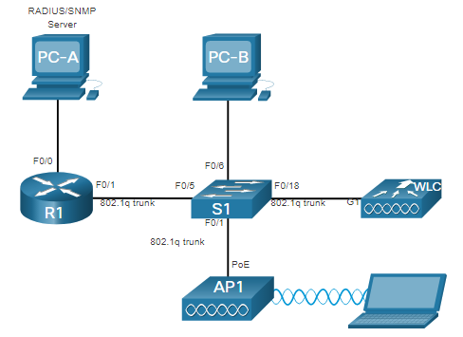
Configure a Basic WLAN on the WLC WLC Topology
The topology and addressing scheme used for this topic are shown in the figure and the table.
The access point (AP) is a controller-based AP as opposed to an autonomous AP, so it requires no initial configuration and is often called lightweight APs (LAPs).
LAPs use the Lightweight Access Point Protocol (LWAPP) to communicate with a WLAN controller (WLC).
Controller-based APs are useful in situations where many APs are required in the network.
As more APs are added, each AP is automatically configured and managed by the WLC.
Device | Interface | IP Address | Subnet Mask
R1 | F0/0 | 172.16.1.1 | 255.255.255.0
R1 | F0/1.1 | 192.168.200.1 | 255.255.255.0
S1 | VLAN 1 | DHCP
WLC | Management | 192.168.200.254 | 255.255.255.0
AP1 | Wired 0 | 192.168.200.3 | 255.255.255.0
PC-A | NIC | 172.16.1.254 | 255.255.255.0
PC-B | NIC | DHCP
Wireless Laptop | NIC | DHCP
Notes:
13 – WLAN Configuration
13.2 – Configure a Basic WLAN on the WLC
13.2.2 – WLC Topology

Slide 31
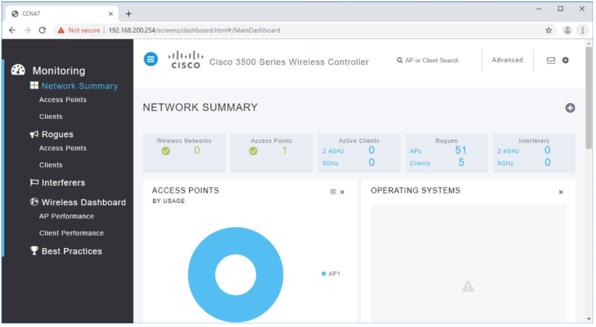
Configure a Basic WLAN on the WLC Log in to the WLC
Configuring a wireless LAN controller (WLC) is not that much different from configuring a wireless router. The WLC controls APs and provides more services and management capabilities.
The user logs into the WLC using credentials that were configured during initial setup.
The Network Summary page is a dashboard that provides a quick overview of configured wireless networks, associated access points (APs), and active clients.
You can also see the number of rogue access points and clients.
Notes:
13 – WLAN Configuration
13.2 – Configure a Basic WLAN on the WLC
13.2.3 – Log in to the WLC

Slide 32
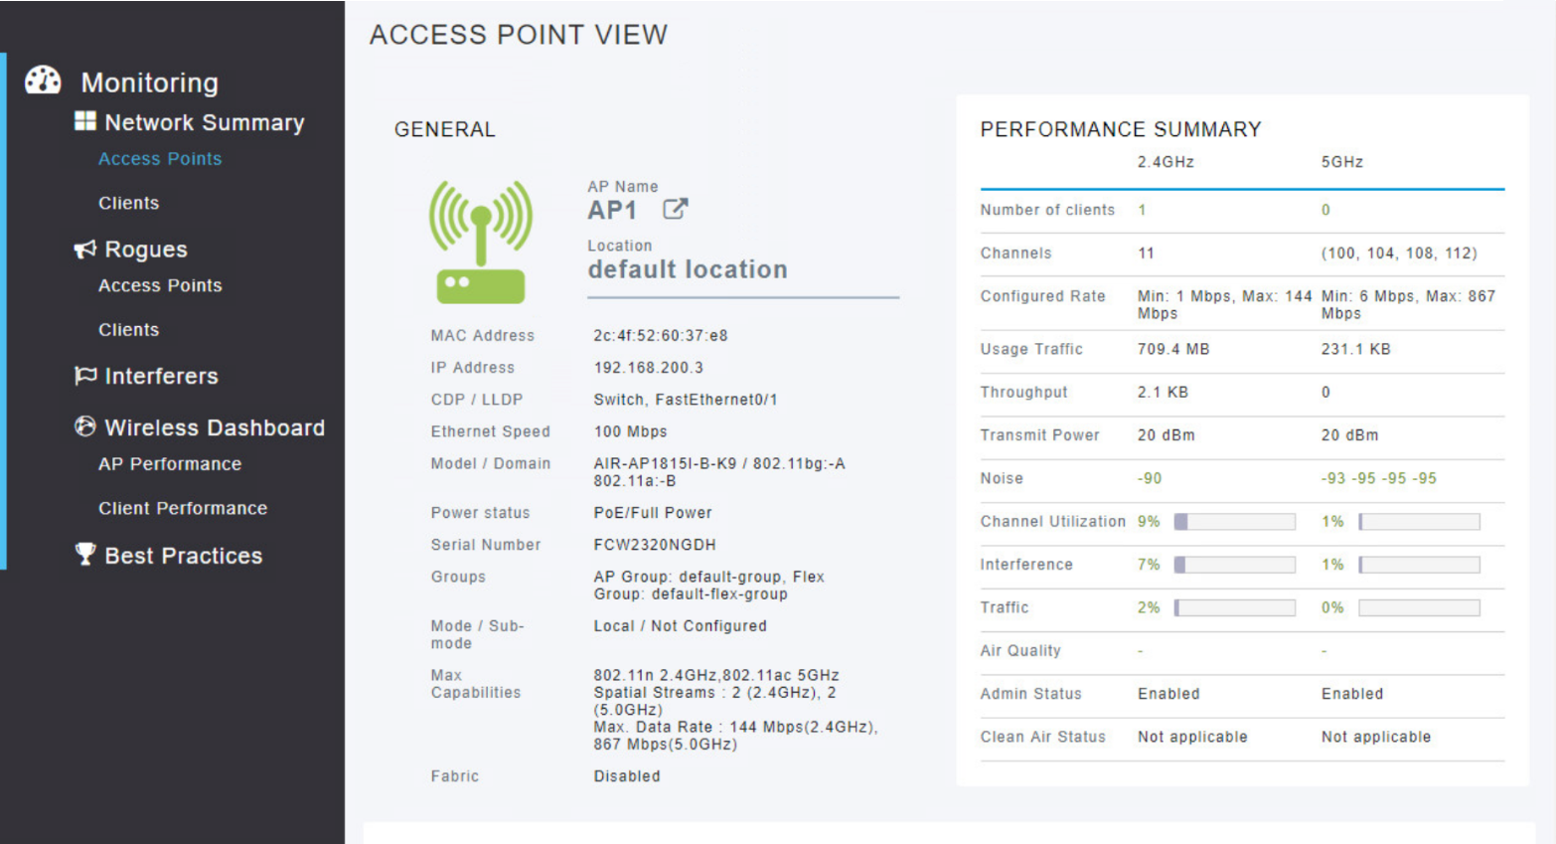
Configure a Basic WLAN on the WLC View AP Information
Click Access Points from the left menu to view an overall picture of the AP’s system information and performance.
The AP is using IP address 192.168.200.3.
Because Cisco Discovery Protocol (CDP) is active on this network, the WLC knows that the AP is connected to the FastEthernet 0/1 port on the switch.
This AP in the topology is a Cisco Aironet 1815i which means you can use the command-line and a limited set of familiar IOS commands.
Notes:
13 – WLAN Configuration
13.2 – Configure a Basic WLAN on the WLC
13.2.4 – View AP Information

Slide 33
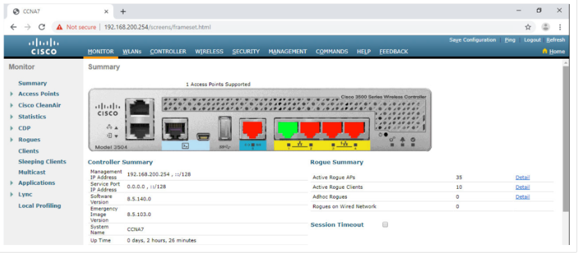
Configure a Basic WLAN on the WLC Advanced Settings
Most WLC will come with some basic settings and menus that users can quickly access to implement a variety of common configurations.
However, as a network administrator, you will typically access the advanced settings.
For the Cisco 3504 Wireless Controller, click Advanced in the upper right-hand corner to access the advanced Summary page.
From here, you can access all the features of the WLC.
Notes:
13 – WLAN Configuration
13.2 – Configure a Basic WLAN on the WLC
13.2.5 - Advanced Settings

Slide 34
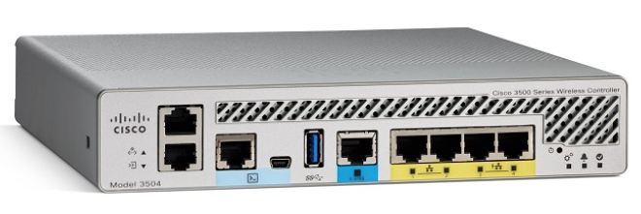
Configure a Basic WLAN on the WLC Configure a WLAN
Wireless LAN Controllers have Layer 2 switch ports and virtual interfaces that are created in software and are very similar to VLAN interfaces.
Each physical port can support many APs and WLANs.
The ports on the WLC are essentially trunk ports that can carry traffic from multiple VLANs to a switch for distribution to multiple APs.
Each AP can support multiple WLANs.
Notes:
13 – WLAN Configuration
13.2 – Configure a Basic WLAN on the WLC
13.2.6 - Configure a WLAN

Slide 35
Configure a Basic WLAN on the WLC Configure a WLAN (Cont.)
Basic WLAN configuration on the WLC includes the following steps:
Create the WLAN
Apply and Enable the WLAN
Select the Interface
Secure the WLAN
Verify the WLAN is Operational
Monitor the WLAN
View Wireless Client Information
Notes:
13 – WLAN Configuration
13.2 – Configure a Basic WLAN on the WLC
13.2.6 - Configure a WLAN (Cont.)

Slide 36
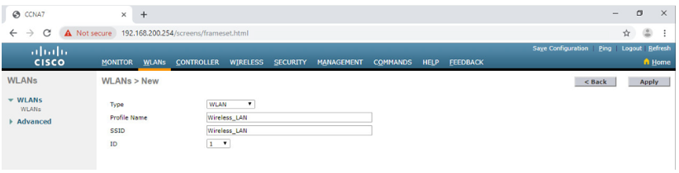
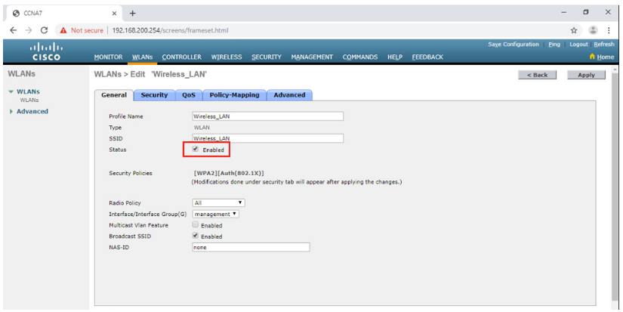
Configure a Basic WLAN on the WLC Configure a WLAN (Cont.)
Create the WLAN: In the figure, a new WLAN with an SSID name Wireless_LAN is created.
Apply and Enable the WLAN: Next the WLAN is enabled the WLAN settings are configured.
Notes:
13 – WLAN Configuration
13.2 – Configure a Basic WLAN on the WLC
13.2.6 - Configure a WLAN (Cont.)

Slide 37
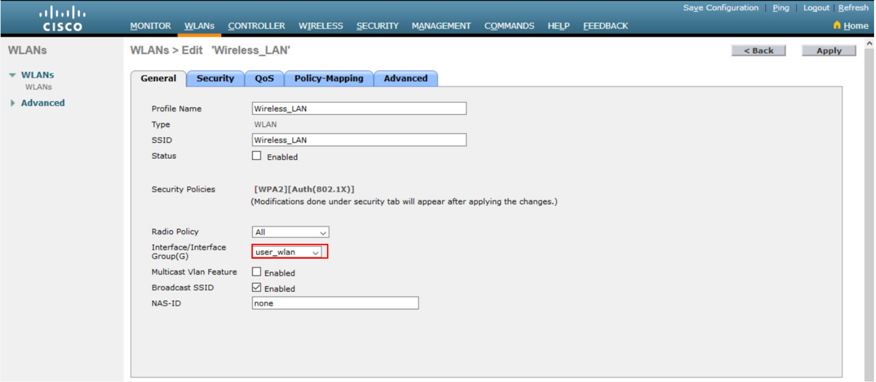
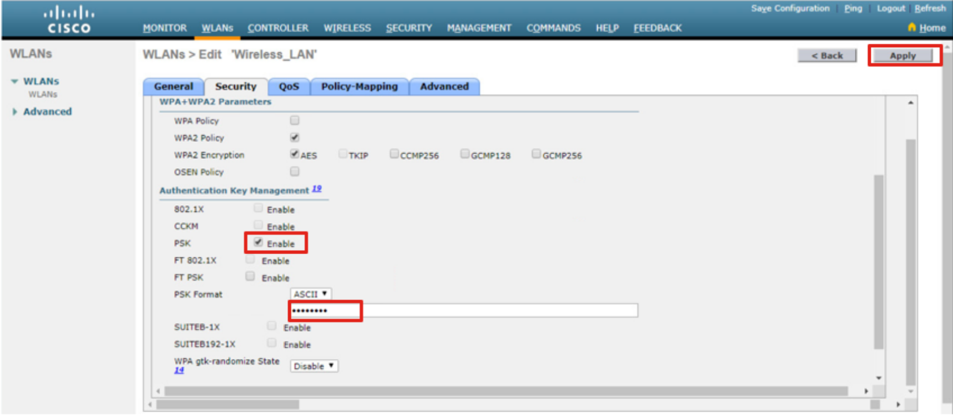
Configure a Basic WLAN on the WLC Configure a WLAN (Cont.)
Select the Interface: The interface that will carry the WLAN traffic must be selected.
Secure the WLAN: The Security tab is used to access all the available options for securing the LAN.
Notes:
13 – WLAN Configuration
13.2 – Configure a Basic WLAN on the WLC
13.2.6 - Configure a WLAN (Cont.)

Slide 38
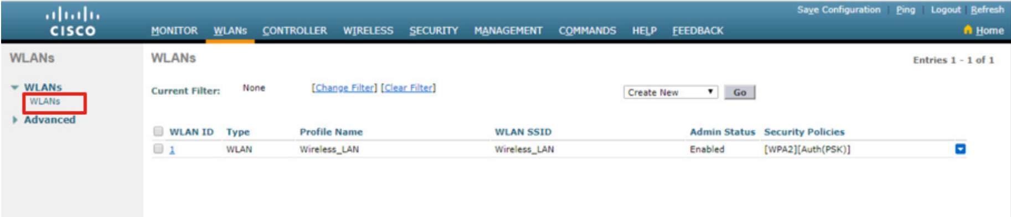
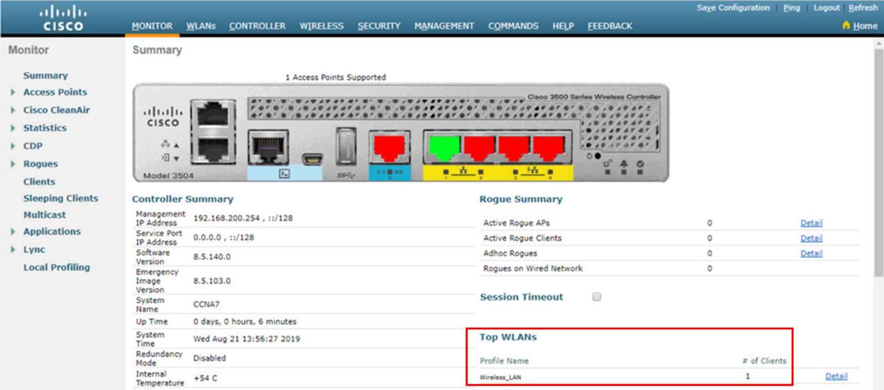
Configure a Basic WLAN on the WLC Configure a WLAN (Cont.)
Verify the WLAN is Operational: The WLANs menu on the left is used to view the newly configured WLAN and its settings.
Monitor the WLAN: The Monitor tab is used to access the advanced Summary page and confirm that the Wireless_LAN now has one client using its services.
Notes:
13 – WLAN Configuration
13.2 – Configure a Basic WLAN on the WLC
13.2.6 - Configure a WLAN (Cont.)

Slide 39
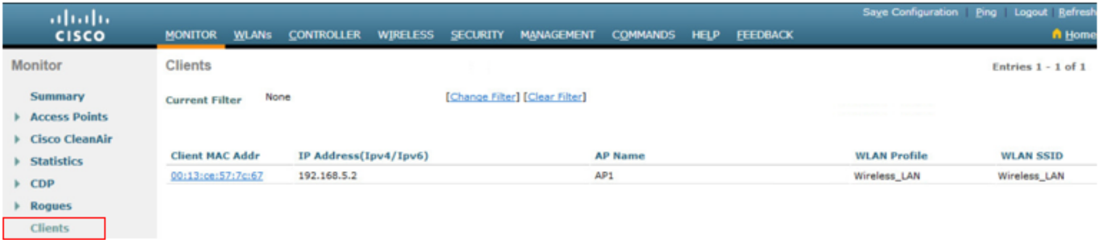
Configure a Basic WLAN on the WLC Configure a WLAN (Cont.)
View Wireless Client Details: Click Clients in the left menu to view more information about the clients connected to the WLAN.
Notes:
13 – WLAN Configuration
13.2 – Configure a Basic WLAN on the WLC
13.2.6 - Configure a WLAN (Cont.)

Slide 40
Configure a Basic WLAN on the WLC Packet Tracer – Configure a Basic WLAN on the WLC
In this lab, you will explore some of the features of a wireless LAN controller.
You will create a new WLAN on the controller and implement security on that LAN.
Then you will configure a wireless host to connect to the new WLAN through an AP that is under the control of the WLC.
Finally, you will verify connectivity.
Notes:
13 – WLAN Configuration
13.2 – Configure a Basic WLAN on the WLC
13.2.7 - Packet Tracer – Configure a Basic WLAN on the WLC

Slide 41
Configure a WPA2 Enterprise WLAN on the WLC
Notes:
13 – WLAN Configuration
13.3 – Configure a WPA2 Enterprise WLAN on the WLC

Slide 42
Configure a WPA2 Enterprise WLAN on the WLC Video – Define an SNMP and RADIUS Server on the WLC
This video will cover the following:
Configure the WLAN controller to send SNMP traps to an external server
Configure the WLAN controller to use an external RADIUS server to authenticate WLAN users
Verify connectivity with the RADIUS server
Notes:
13 – WLAN Configuration
13.3 – Configure a WPA2 Enterprise WLAN on the WLC
13.3.1 - Video – Define an SNMP and RADIUS Server on the WLC

Slide 43
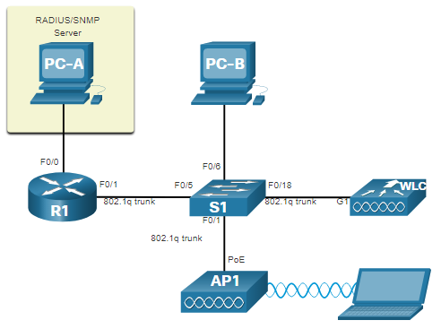
Configure a WPA2 Enterprise WLAN on the WLC SNMP and RADIUS
PC-A is running Simple Network Management Protocol (SNMP) and Remote Authentication Dial-In User Service (RADIUS) server software.
The network administrator wants the WLC to forward all SNMP log messages (i.e., traps) to the SNMP server.
The network administrator wants to use a RADIUS server for authentication, authorization, and accounting (AAA) services.
Users will enter their username and password credentials which will be verified by the RADIUS server.
The RADIUS server is required for WLANs that are using WPA2 Enterprise authentication.
Note: SNMP server and RADIUS server configuration is beyond the scope of this module.
Notes:
13 – WLAN Configuration
13.3 – Configure a WPA2 Enterprise WLAN on the WLC
13.3.2 - SNMP and RADIUS

Slide 44
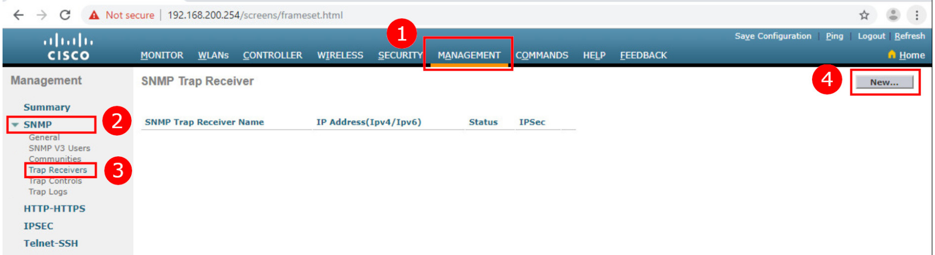
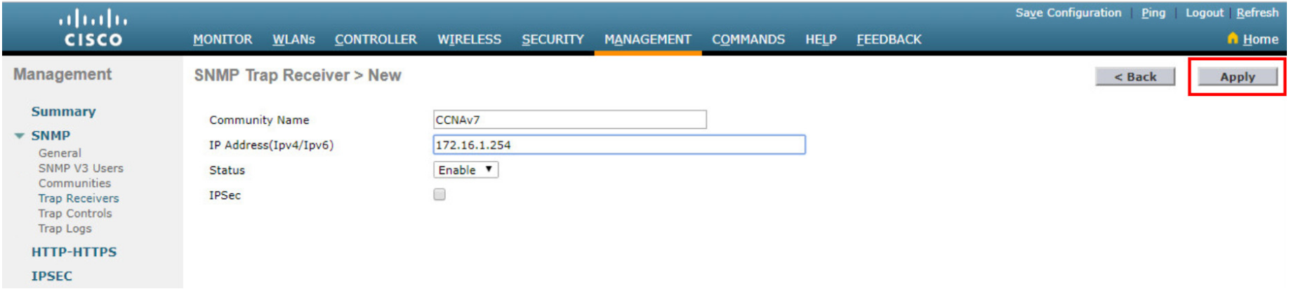
Configure a WPA2 Enterprise WLAN on the WLC Configure SNMP Server Information
To enable SNMP and configure settings:
Click the MANAGEMENT tab to access a variety of management features.
Click SNMP to expand the sub-menus.
Click Trap Receivers.
Click New... to configure a new SNMP trap receiver.
Enter the SNMP Community name and the IP address (IPv4 or IPv6) for the SNMP server and then click Apply.
The WLC will now forward SNMP log messages to the SNMP server.
Notes:
13 – WLAN Configuration
13.3 – Configure a WPA2 Enterprise WLAN on the WLC
13.3.3 - Configure SNMP Server Information

Slide 45
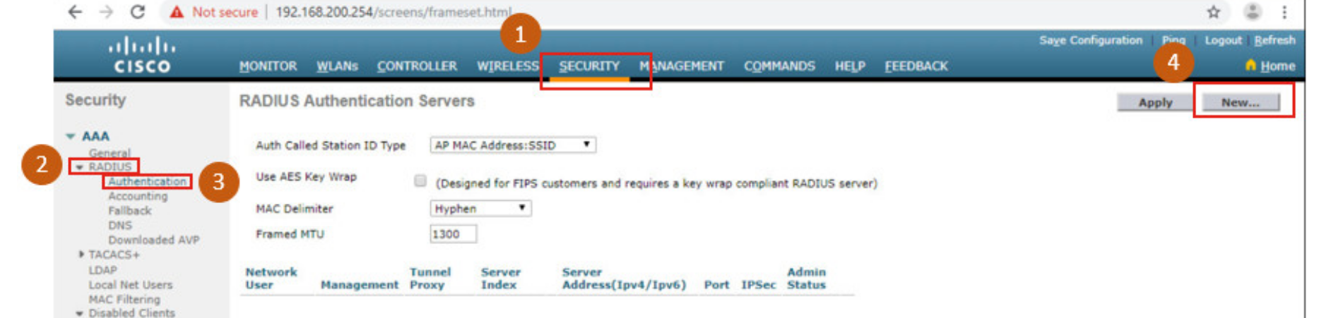
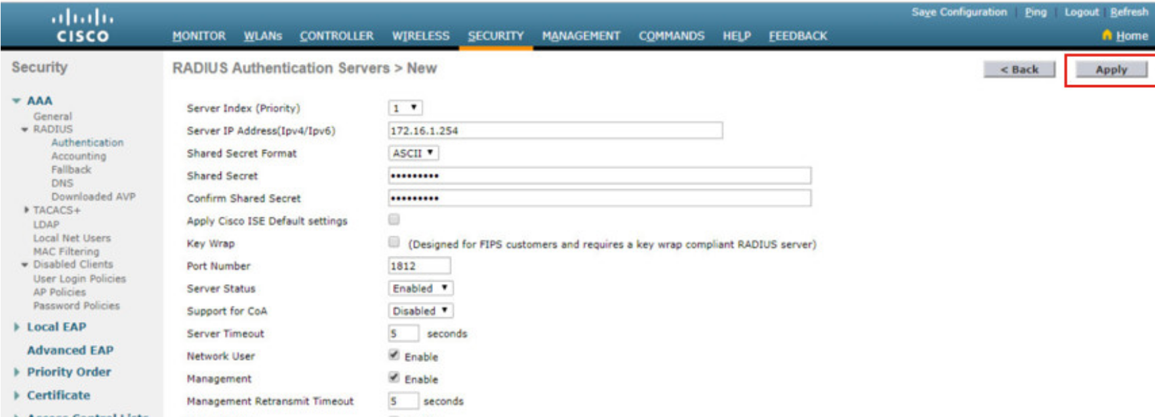
Configure a WPA2 Enterprise WLAN on the WLC Configure RADIUS Server Information
To configure the WLC with the RADIUS server information:
Click SECURITY.
Click RADIUS
Click Authentication
Click New... to add PC-A as the RADIUS server.
Enter the IPv4 address for PC-A and the shared secret that will be used between the WLC and the RADIUS server and then click Apply.
Notes:
13 – WLAN Configuration
13.3 – Configure a WPA2 Enterprise WLAN on the WLC
13.3.4 - Configure RADIUS Server Information

Slide 46
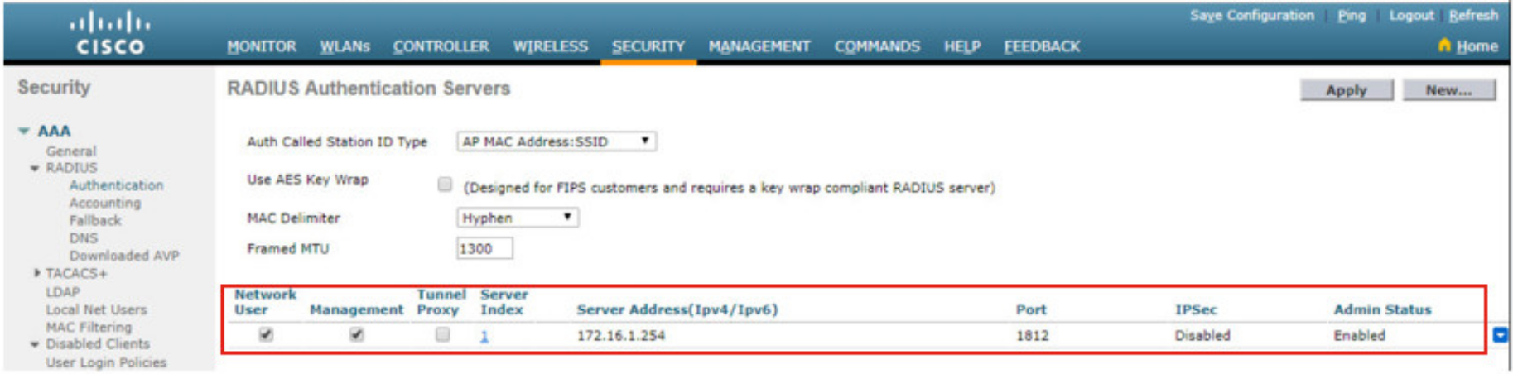
Configure a WPA2 Enterprise WLAN on the WLC Configure RADIUS Server Information (Cont.)
After clicking Apply, the list of configured RADIUS Authentication Servers refreshes with the new server listed.
Notes:
13 – WLAN Configuration
13.3 – Configure a WPA2 Enterprise WLAN on the WLC
13.3.4 - Configure RADIUS Server Information (Cont.)

Slide 47
Configure a WPA2 Enterprise WLAN on the WLC Video – Configure a VLAN for a New WLAN
This video will cover the following:
Review the topology
Deploy a new VLAN interface
Associate the new VLAN interface with a WLAN
Notes:
13 – WLAN Configuration
13.3 – Configure a WPA2 Enterprise WLAN on the WLC
13.3.5 - Video – Configure a VLAN for a New WLAN

Slide 48
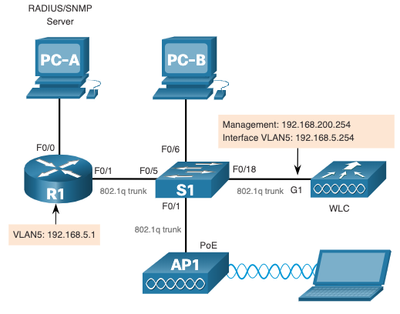
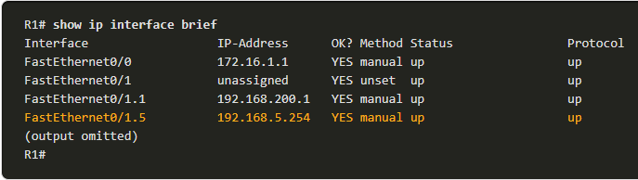
Configure a WPA2 Enterprise WLAN on the WLC Topology with VLAN 5 Addressing
Each WLAN configured on the WLC needs its own virtual interface.
The WLC has five physical data ports that can be configured to support multiple WLANs and virtual interface.
The new WLAN will use interface VLAN 5 and network 192.168.5.0/24 and therefore R1 has been configured for VLAN 5 as shown in the topology and show ip interface brief output.
Notes:
13 – WLAN Configuration
13.3 – Configure a WPA2 Enterprise WLAN on the WLC
13.3.6 –Topology with VLAN 5 Addressing

Slide 49
Configure a WPA2 Enterprise WLAN on the WLC Configure a New Interface
VLAN interface configuration on the WLC includes the following steps:
Create a new interface.
Configure the VLAN name and ID.
Configure the port and interface address.
Configure the DHCP server address.
Apply and Confirm.
Verify Interfaces.
Notes:
13 – WLAN Configuration
13.3 – Configure a WPA2 Enterprise WLAN on the WLC
13.3.7 - Configure a New Interface

Slide 50
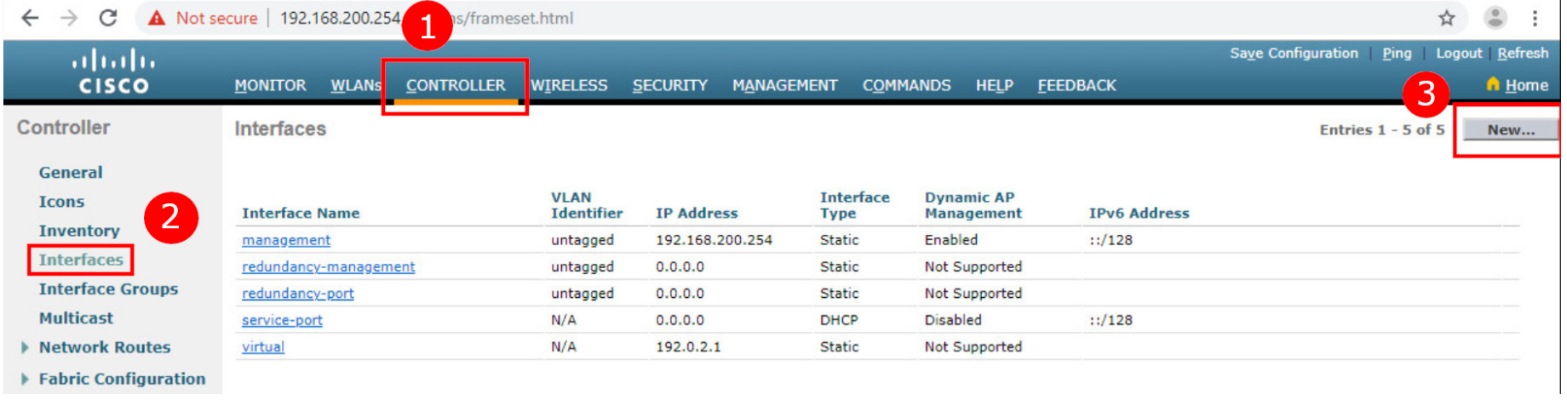
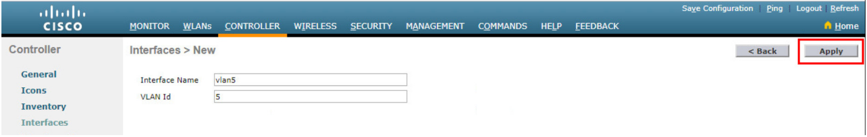
Configure a WPA2 Enterprise WLAN on the WLC Configure a New Interface (Cont.)
Create a new interface: Click CONTROLLER > Interfaces > New...
Configure the VLAN name and ID: In the example, the new interface is named vlan5, the VLAN ID is 5, and applied.
Notes:
13 – WLAN Configuration
13.3 – Configure a WPA2 Enterprise WLAN on the WLC
13.3.7 - Configure a New Interface (Cont.)

Slide 51
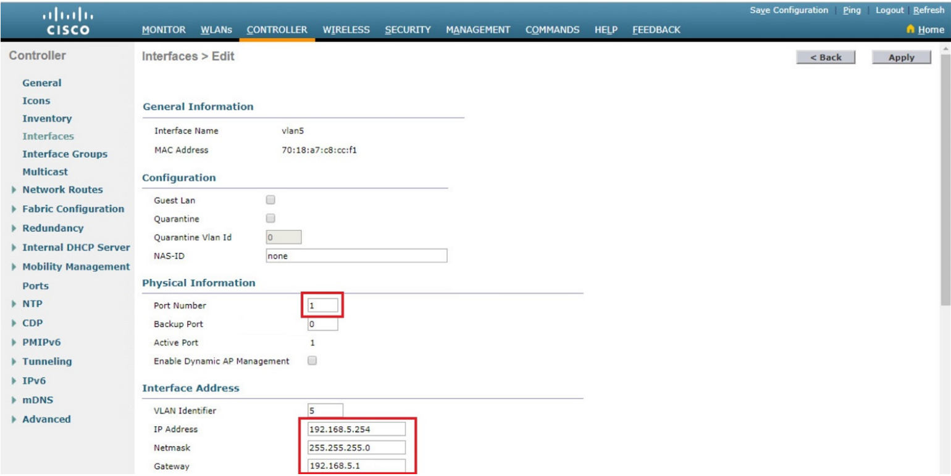
Configure a WPA2 Enterprise WLAN on the WLC Configure a New Interface (Cont.)
Configure the port and interface address: On the interface Edit page, configure the physical port number (i.e., the WLC G1 interface is Port Number 1 on the WLC), the VLAN 5 interface addressing (i.e., 192.168.5.254/24), and the default gateway (i.e., 192.168.5.1)
Notes:
13 – WLAN Configuration
13.3 – Configure a WPA2 Enterprise WLAN on the WLC
13.3.7 - Configure a New Interface (Cont.)

Slide 52
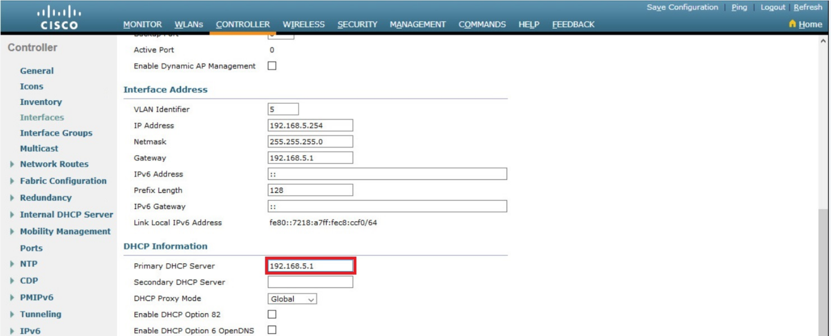
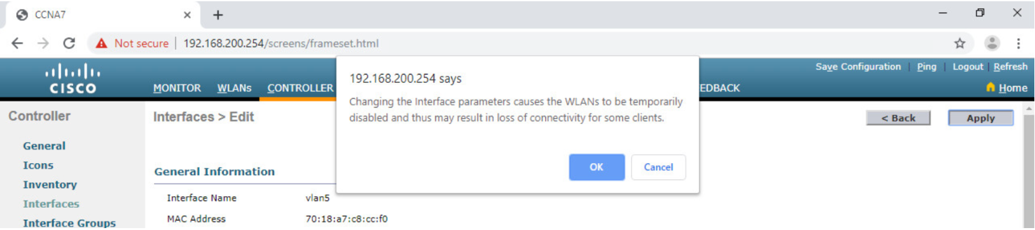
Configure a WPA2 Enterprise WLAN on the WLC Configure a New Interface (Cont.)
Configure the DHCP server address: The example configures a primary DHCP server at IPv4 address 192.168.5.1 which is the default gateway router address which is enabled as a DHCP server.
Apply and Confirm: Scroll to the top and click Apply and then click OK for the warning message.
Notes:
13 – WLAN Configuration
13.3 – Configure a WPA2 Enterprise WLAN on the WLC
13.3.7 - Configure a New Interface (Cont.)

Slide 53
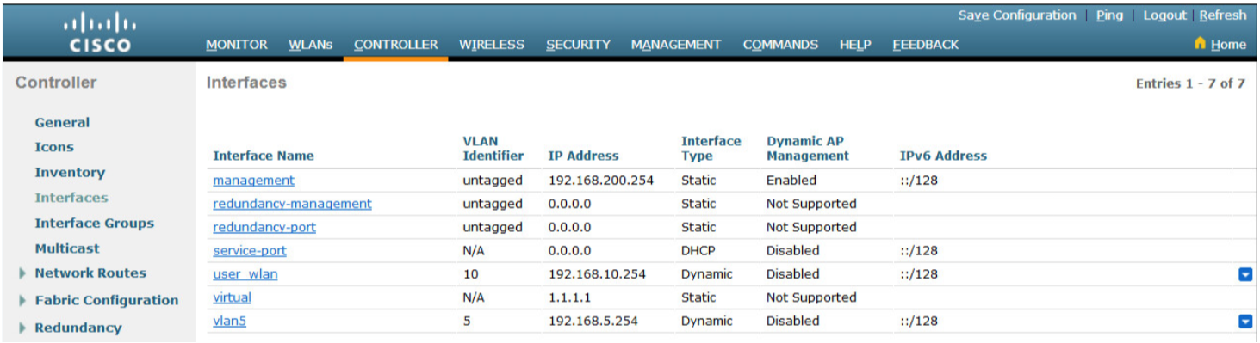
Configure a WPA2 Enterprise WLAN on the WLC Configure a New Interface (Cont.)
Verify Interfaces: Click Interfaces to verify that the new vlan5 interface is shown in the list of interfaces with its IPv4 address.
Notes:
13 – WLAN Configuration
13.3 – Configure a WPA2 Enterprise WLAN on the WLC
13.3.7 - Configure a New Interface (Cont.)

Slide 54
Configure a WPA2 Enterprise WLAN on the WLC Video – Configure a DHCP Scope
This video will cover the following:
Review the topology
Explain the role of the WLC DHCP server
Create a new DHCP scope
Notes:
13 – WLAN Configuration
13.3 – Configure a WPA2 Enterprise WLAN on the WLC
13.3.8 - Video – Configure DHCP for the New WLAN

Slide 55
Configure a WPA2 Enterprise WLAN on the WLC Configure a DHCP Scope
DHCP scope configuration includes the following steps:
Create a new DHCP scope.
Name the DHCP scope.
Verify the new DHCP scope.
Configure and enable the new DHCP scope.
Verify the enable DHCP scope
Notes:
13 – WLAN Configuration
13.3 – Configure a WPA2 Enterprise WLAN on the WLC
13.3.9 - Configure a DHCP Scope

Slide 56
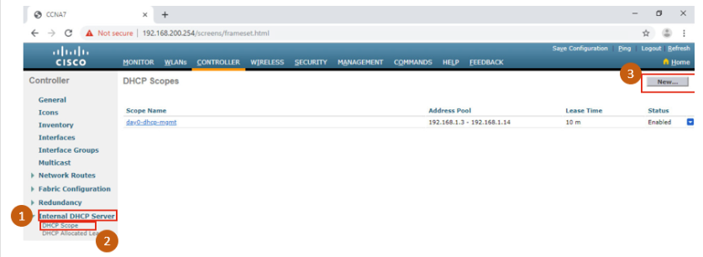
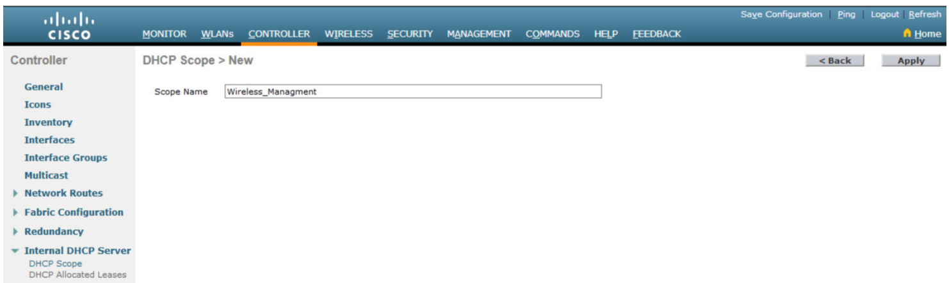
Configure a WPA2 Enterprise WLAN on the WLC Configure a DHCP Scope (Cont.)
Create a new DHCP scope: To configure a new DHCP scope, click Internal DHCP Server > DHCP Scope > New....
Name the DHCP scope: The scope is named Wireless_Management and then applied.
Notes:
13 – WLAN Configuration
13.3 – Configure a WPA2 Enterprise WLAN on the WLC
13.3.9 - Configure a DHCP Scope (Cont.)

Slide 57
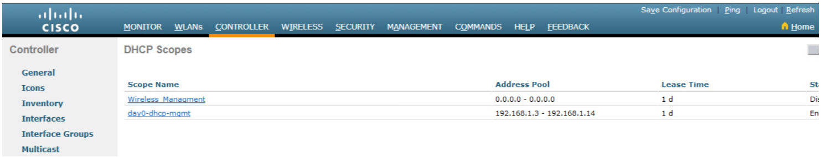
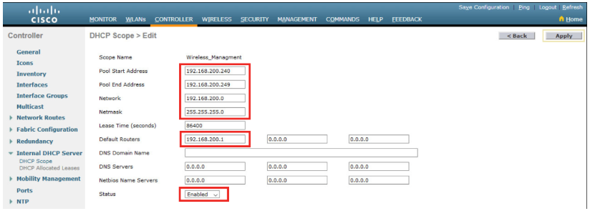
Configure a WPA2 Enterprise WLAN on the WLC Configure a DHCP Scope (Cont.)
Verify the new DHCP scope: In the DHCP Scopes page click the new Scope Name to configure the DHCP scope.
Configure and enable the new DHCP scope: On the Edit screen for the Wireless_Management scope, configure a pool of addresses (i.e., 192.168.200.240/24 to .249), the default router IPv4 address (i.e., 192.168.200.1), then Enabled and Apply.
Notes:
13 – WLAN Configuration
13.3 – Configure a WPA2 Enterprise WLAN on the WLC
13.3.9 - Configure a DHCP Scope (Cont.)

Slide 58
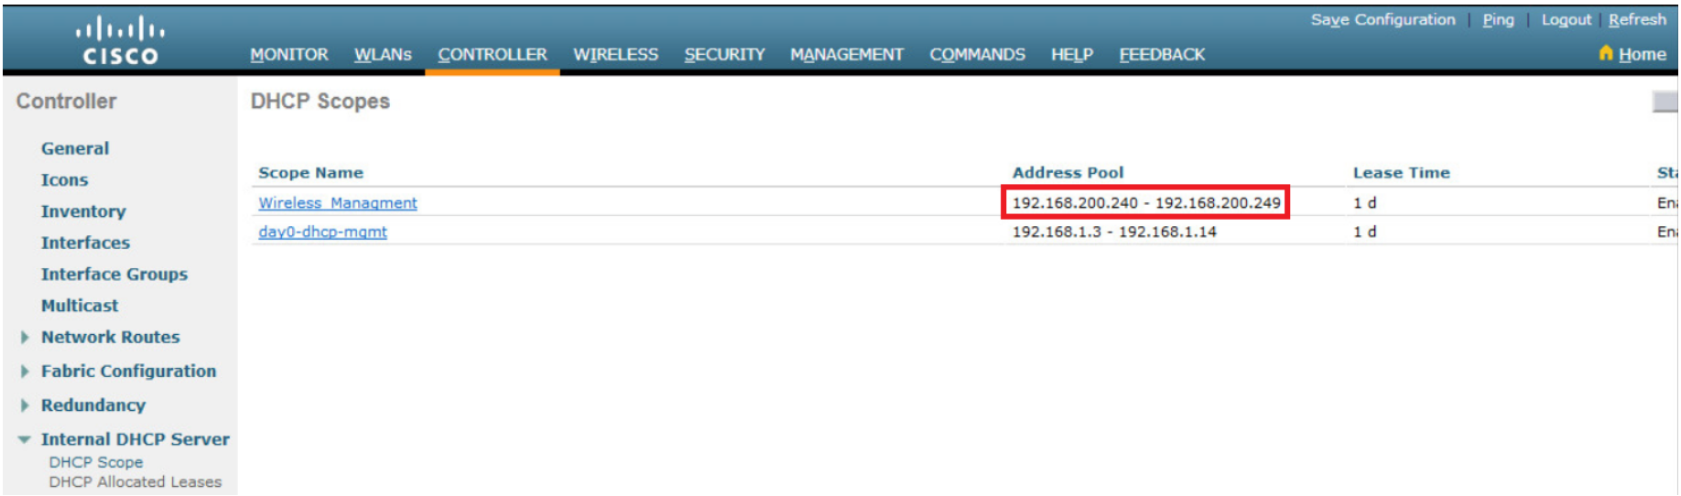
Configure a WPA2 Enterprise WLAN on the WLC Configure a DHCP Scope (Cont.)
Verify the enable DHCP scope: The network administrator is returned to the DHCP Scopes page and can verify the scope is ready to be allocated to a new WLAN.
Notes:
13 – WLAN Configuration
13.3 – Configure a WPA2 Enterprise WLAN on the WLC
13.3.9 - Configure a DHCP Scope (Cont.)

Slide 59
Configure a WPA2 Enterprise WLAN on the WLC Video – Configure a WPA2 Enterprise WLAN
This video will cover the following:
Review the topology
Create a WLAN
Configure the WLC to use the RADIUS server
Secure the new WLAN with WPA2-Enterprise
Verify WPA2-Enterprise Security
Notes:
13 – WLAN Configuration
13.3 – Configure a WPA2 Enterprise WLAN on the WLC
13.3.10 - Video – Configure a WPA2 Enterprise WLAN

Slide 60
Configure a WPA2 Enterprise WLAN on the WLC Configure a WPA2 Enterprise WLAN
By default, all newly created WLANs on the WLC will use WPA2 with Advanced Encryption System (AES).
802.1X is the default key management protocol used to communicate with the RADIUS server.
Next, create a new WLAN to use interface vlan5.
Configuring a new WLAN on the WLC includes the following steps:
Create a new WLAN.
Configure the WLAN name and SSID.
Enable the WLAN for VLAN 5.
Verify AES and 802.1X defaults.
Configure WLAN security to use the RADIUS server.
Verify the new WLAN is available.
Notes:
13 – WLAN Configuration
13.3 – Configure a WPA2 Enterprise WLAN on the WLC
13.3.11 - Configure a WPA2 Enterprise WLAN

Slide 61
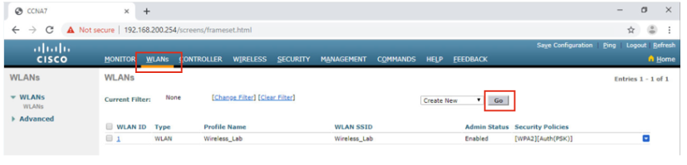
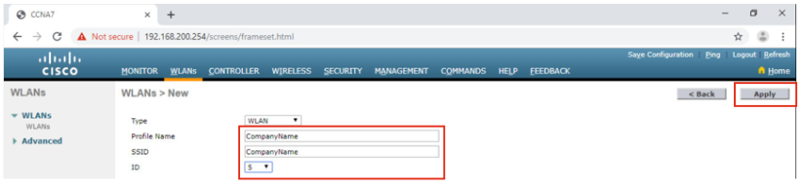
Configure a WPA2 Enterprise WLAN on the WLC Configure a WPA2 Enterprise WLAN (Cont.)
Create a new WLAN: Click the WLANs tab and then Go to create a new WLAN.
Configure the WLAN name and SSID: Enter the profile name and SSID, choose an ID of 5, and then click Apply to create the new WLAN.
Notes:
13 – WLAN Configuration
13.3 – Configure a WPA2 Enterprise WLAN on the WLC
13.3.11 - Configure a WPA2 Enterprise WLAN (Cont.)

Slide 62
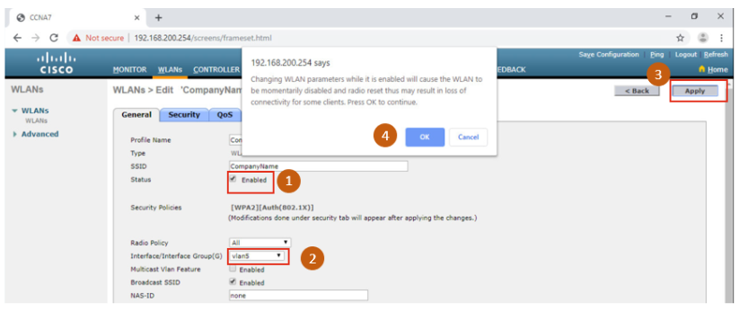
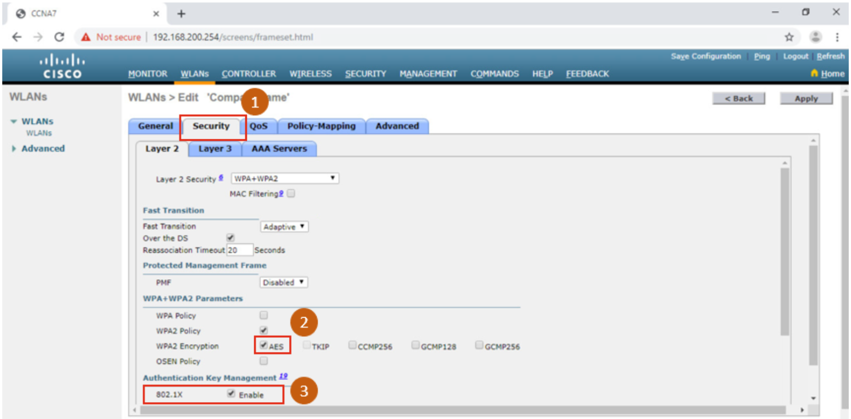
Configure a WPA2 Enterprise WLAN on the WLC Configure a WPA2 Enterprise WLAN (Cont.)
Enable the WLAN for VLAN 5: Once the WLAN, change the status to Enabled, choose vlan5 from the Interface/Interface Group(G) dropdown list, and then click Apply and click OK to accept the popup message.
Verify AES and 802.1X defaults: Click the Security tab to view the default security configuration for the new WLAN.
Notes:
13 – WLAN Configuration
13.3 – Configure a WPA2 Enterprise WLAN on the WLC
13.3.11 - Configure a WPA2 Enterprise WLAN (Cont.)

Slide 63
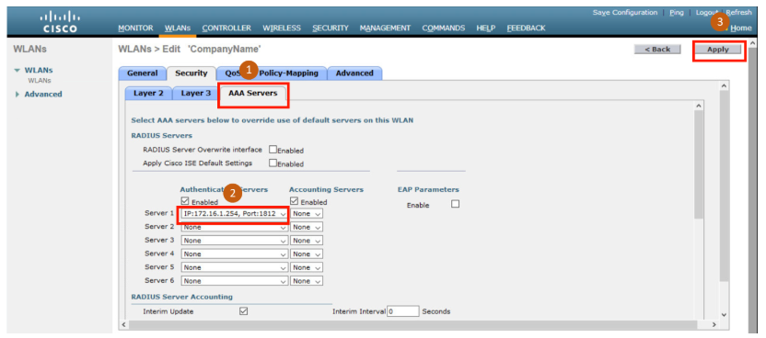
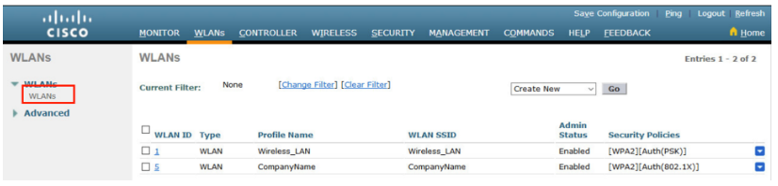
Configure a WPA2 Enterprise WLAN on the WLC Configure a WPA2 Enterprise WLAN (Cont.)
Configure the RADIUS server: To select the RADIUS server that will be used to authenticate WLAN users, click the AAA Servers tab and in the dropdown box, select the RADIUS server that was configured on the WLC previously, and then Apply your changes.
Verify that the new WLAN is available: To verify that the new WLAN is listed and enabled click on the WLANs submenu.
Notes:
13 – WLAN Configuration
13.3 – Configure a WPA2 Enterprise WLAN on the WLC
13.3.11 - Configure a WPA2 Enterprise WLAN (Cont.)

Slide 64
Module Practice and Quiz
Notes:
12 - WLAN Concepts
12.8 – Module Practice and Quiz

Slide 65
Quick Review Question
Refer to Quiz - Chapter 6 in Cisco Networking Academy platform
In this Packet Tracer, you will complete the following:
In this Packet Tracer activity, you will configure a new WLAN on a wireless LAN controller (WLC), including the VLAN interface that it will use. You will configure the WLAN to use a RADIUS server and WPA2-Enterprise to authenticate users. You will also configure the WLC to use an SNMP server.

Slide 66
Summary of Main Teaching Points
A Wireless LANs (WLANs) are based on IEEE standards and can be classified into four main types: WPAN, WLAN, WMAN, and WWAN.
Wireless technology uses the unlicensed radio spectrum to send and receive data. Examples of this technology are Bluetooth, WiMAX, Cellular Broadband, and Satellite Broadband.
WLAN networks operate in the 2.4 GHz frequency band and the 5 GHz band.
Wireless LAN devices have transmitters and receivers tuned to specific frequencies of radio waves to communicate.
The 802.11b/g/n standards operate in the 2.4 GHz to 2.5GHz spectrum. The 2.4 GHz band is subdivided into multiple channels. Each channel is allotted 22 MHz bandwidth and is separated from the next channel by 5 MHz.
Wireless networks are susceptible to threats, including: data interception, wireless intruders, DoS attacks, and rogue APs.
To keep wireless intruders out and protect data, two early security features are still available on most routers and APs: SSID cloaking and MAC address filtering.
There are four shared key authentication techniques available: WEP, WPA, WPA2, and WPA3.

Slide 67
Question and Answer Session
Q & A

Slide 68
What we will cover next
LAN Security Concepts

